Slide 1

Health
Insurance
Amount
Prediction
Batch – B11
19K41A0573
19K41A05C0
19K41A0571
20K45A0509

Slide 2

Problem Statement
Health insurance is a necessity nowadays. And factor determining the amount of insurance vary from company to company. Many people get confused and will get into wrong assumptions. We want to help the people to get out of that confusion. We use machine learning algorithms to predict this.

Slide 3
Proposed System
We analyse the personal health data to predict insurance amount of individual. The goal is to allow a person to get an idea about the necessary amount required according to their health status. Our project may give the nearer amount and give the idea to the individual about their situation.

Slide 4
Block Diagram of Proposed system
Dataset
Collection
Training
the
model
Predict using
Machine
Learning
models
Plotting
the
graphs
Getting
the
final
Result

Slide 5
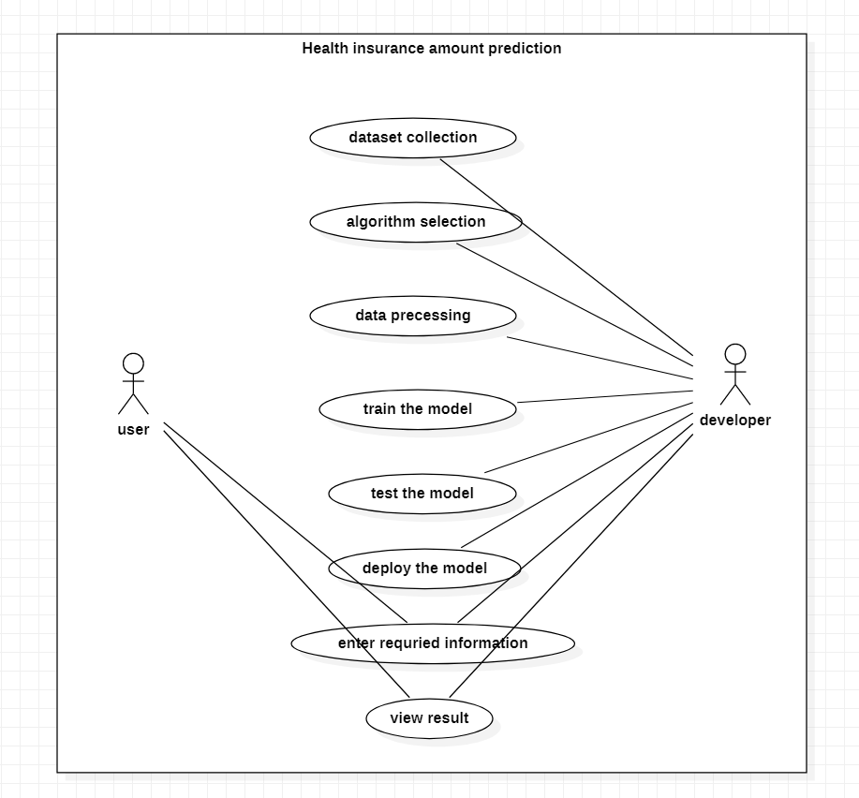
Use Case Diagram

Slide 6
Data Insights
Age
Male/Female [0/1]
BMI
No. of children
Smoking – yes/no [0/1]
Region [1-southwest
2-southeast
3-northwest
4-northeast]

Slide 7
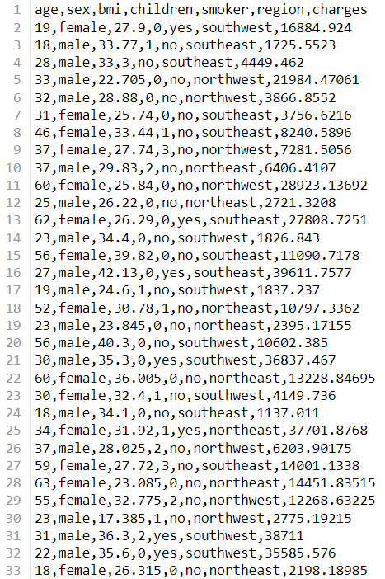
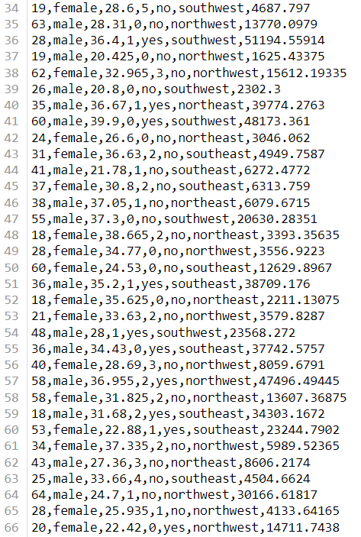
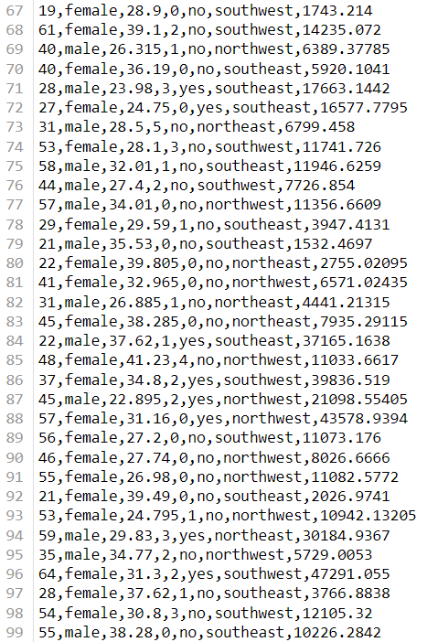
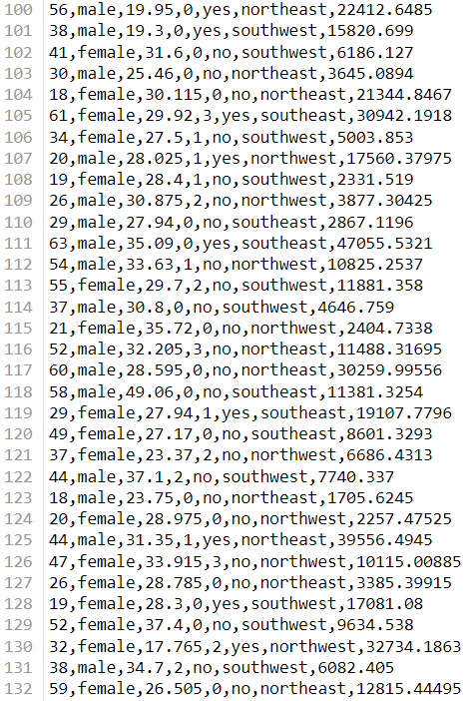
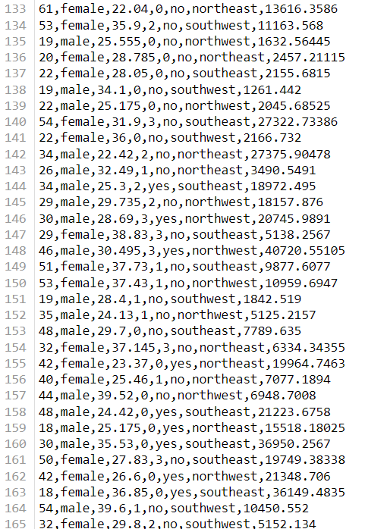
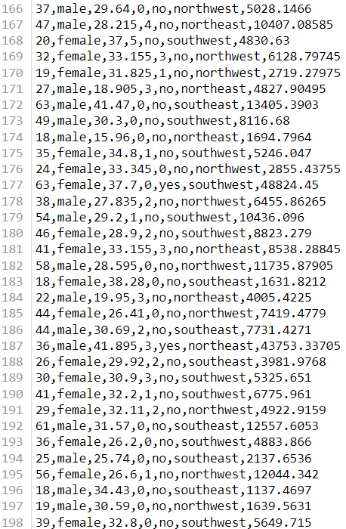
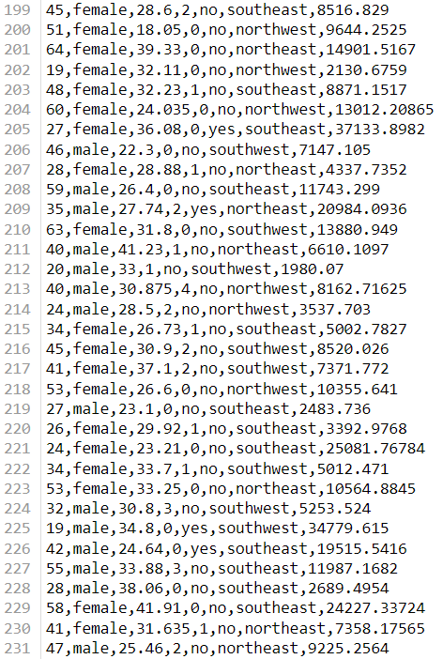
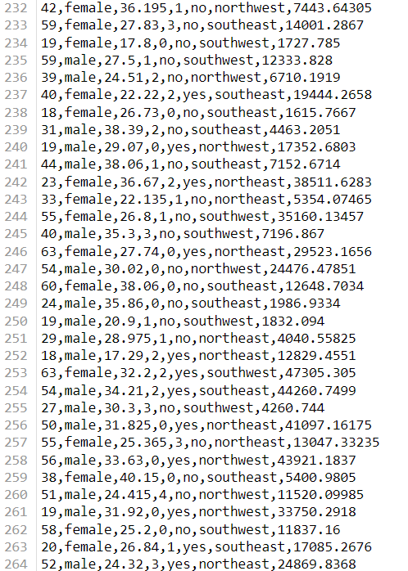
Dataset

Slide 8
Implementation
Three regression models naming Multiple Regression, Decision tree and Random Forest have been used to compare and contrast the performance of these algorithms. Dataset was used for training the models and that training helped to come up with some predictions. Then the predicted amount was compared with the actual data to test and verify the model. Later the accuracies of these models were compared.

Slide 9
Machine Learning Model
We use different machine learning models.
Multiple Regression
Random Forest
Decision Tree

Slide 10
Comparative Results
Model | Training Accuracy | Testing Accuracy
Multiple Regression | 74.36639 | 77.14801
Random Forest | 93.36814 | 87.07829
Decision Tree | 97.00801 | 77.44010

Slide 11
Error/Model | Multiple Regression | Random Forest | Decision Tree
Root mean square error | 0.09678 | 0.07279 | 0.0699
Mean square error | 0.0093 | 0.0052 | 0.0048
Mean absolute error | 0.0686 | 0.0366 | 0.03649
We have to consider the testing accuracy. As we have got the highest accuracy for the random forest model we will use that algorithm for preparing our model.

Slide 12
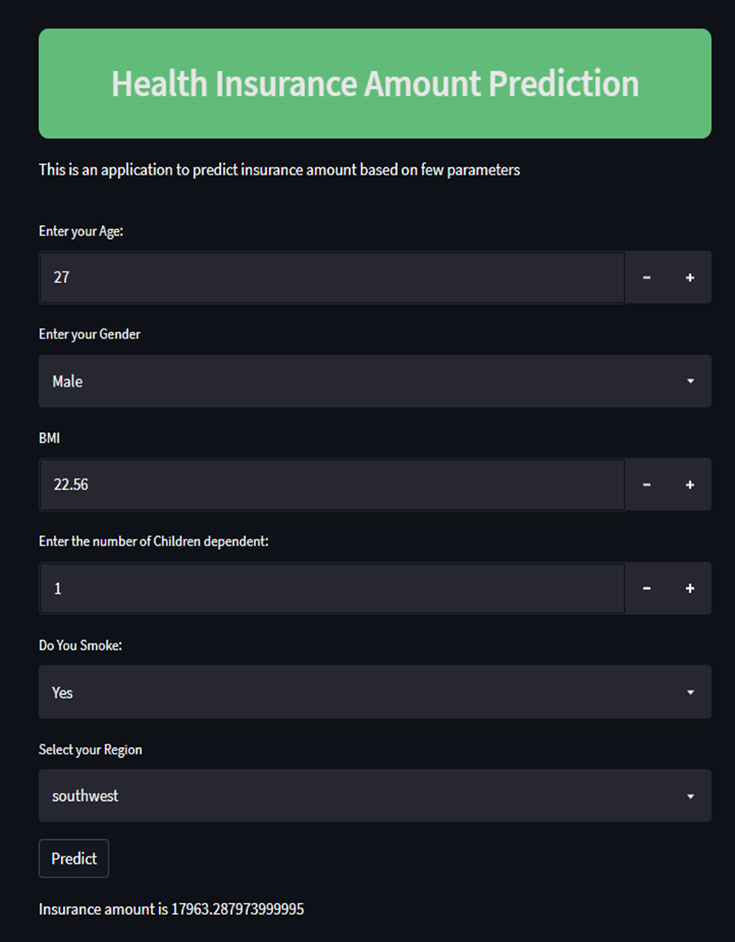
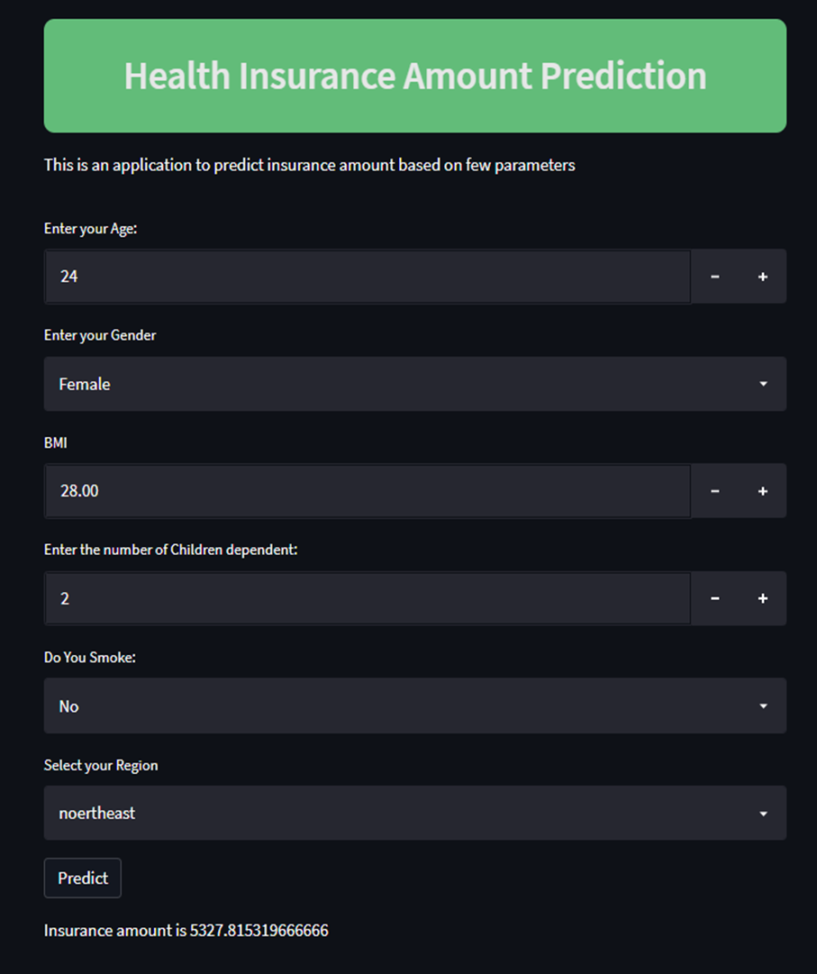
Application

Slide 13
This application can be accessed by using a URL.
URL:
web app

Slide 14
Conclusion
The research uses various machine learning regression models and deep neural networks to forecast charges of health insurance based on specific attributes, on medical cost personal data set from Kaggle.com. The Random Forest Regression offers the best efficiency, with an RMSE value of 0.07291, an MAE value of 0.036628, and an accuracy of 87.078291. Random Forest Regression can therefore be used in the estimation of insurance costs with better performance than other regression models. Forecasting insurance costs based on certain factors help insurance policy providers to attract consumers and save time in formulating plans for every individual. Machine learning can significantly minimize these individual efforts in policymaking, as ML models can do cost calculation in a short time, while a human being would be taking a long time to perform the same task. This will help businesses improve their profitability. The ML models can also manage enormous amounts of data.

Slide 15


